Slide 1
AIMS Redesign Subcommittee
April 1st, 2024
Full-Committee Meeting

Slide 2
Agenda
Dashboards
Recap
Template Changes
Additional Metrics
Wording Changes

Slide 3
Recap
Template Changes
Additional Metrics
Wording Changes
Dashboards
Exploring different data visualization platforms
Tableau Public
Significantly discounted developer license
Doesn’t require viewer license
Dashboard/Data stored on public server
Anyone can view dashboard
Can prevent download/viewing of dataset
Can limit to high level non-sensitive data
Is this still useful for TCUs?
Tableau Cloud
Avoids public access
Data still stored on a third-party server and out of our control
Requires individual viewer license to access the dashboard (1 per TCU)

Slide 4
Recap
Template Changes
Additional Metrics
Wording Changes
JD Lopez Review of AIMS
Overall positive feedback
Potential areas of expansion
Student Success metrics at the systems level
Assessing data use within TCUs
Will come to May 6th meeting to review

Slide 5
Recap
Template Changes
Additional Metrics
Wording Changes
November Meeting Recap
Variables Added
IRB
Census Day
Institutional Office
Language space/building
Existing Variables to Cut
Academic Core Enrollment Completion
Academic Competitiveness Grant (Financial Aid)
Undeclared/Non-Declared Major Group
Average Family Income (Replace with Student Aid Index)
Current Student Costs
Add CIP codes to program offerings

Slide 6
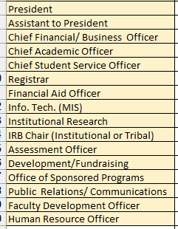
Recap
Template Changes
Additional Metrics
Wording Changes
Fall Survey
Length of CIP Codes to Collect
Lengths: 2, 4, and 6 digits
2 = General content area
4 = Intermediate program groupings of comparable content
6 = Specific instructional program
4 digit CIP Code is good/6 digit CIP Code is better
IPEDS & PDP = 6 digits?
Limit Current Administration List
Won’t be able to add additional positions
Additional positions are unreferenced
Cleaner structure on the back end
Add IRB Chair (Institutional or Tribal) position?
Open to adding positions for all institutions

Slide 7
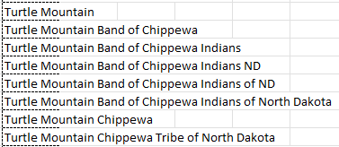
Annual Survey
Student Demographics Reporting Period
Can’t figure out why:
First-Time Student Tab: Collected over the entire academic year.
General Student Tab: Collected only for the fall term.
Any advantage for institutions?
First Time Students: Fall vs. Academic year?
If fall, include lagging summer?
Tribal Affiliations
Challenges with Unique Tribe Count
8 unique submissions for the Turtle Mountain Band of Chippewa Indians
Proposed Solution
Drop downlist of federally recognized tribes
Include broader tribal categories (e.g., “Chippewa” or “Navajo”) when students don’t specify a specific tribe
State Recognized Tribal List also Loaded
Recap
Template Changes
Additional Metrics
Wording Changes

Slide 8
Recap
Template Changes
Additional Metrics
Wording Changes
Annual Survey
2024 Part B
Separate Word doc or Excel Tab?
External Academic Award Student Activity
Suggested to be removed by codebook working group
Complexity: Identifying which external awards to include, tracking them, and understanding their significance is challenging.
Quality: Evaluating the legitimacy and quality of awarding organizations is difficult.
Uncertainty: The meaning behind the numbers associated with external awards remains unclear.

Slide 9
Recap
Template Changes
Additional Metrics
Wording Changes
Annual Survey
Identify which sections should be duplicated vs. unduplicated numbers

Slide 10
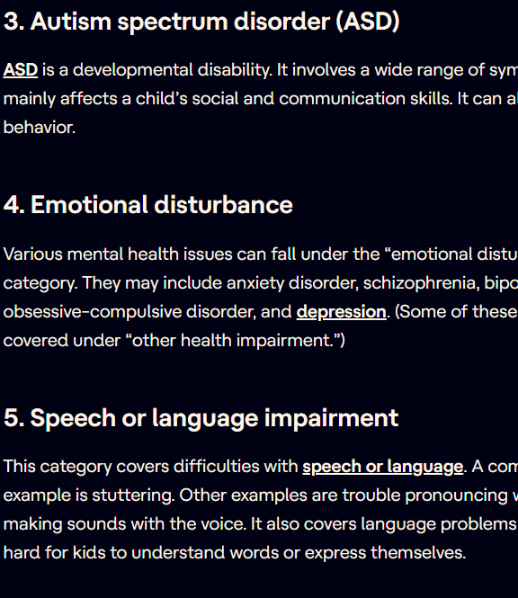
Additional Metrics
Students with Health Conditions/ Impairments Tab
Type of impairment
Individuals with Disabilities Education Act has a list of 13 categories
Accommodations provided by institution
Transfer Student Tab?
Transfer-Out rate
Transfer-In enrollment
Institution transferring from
Incoming credits
Previous Degree Program
Enrolled Degree Program
Demographics?
Recap
Template Changes
Additional Metrics
Wording Changes

Slide 11
Additional Metrics
Anytime Graduation Rate
Student Employment Status (While Enrolled)
Part-Time
Full-Time
Seasonal
Not-Working
Internet Connectivity
ISP Provider
Connectivity Speeds (in Mps)
Annual Internet Costs
Recap
Template Changes
Additional Metrics
Wording Changes

Slide 12
Additional Metrics
International Students:
International Student Enrollment by Visa Type
F-1, J-1, and M-1
Student’s Home Country
Program of Enrollment
Financial Aid offered
Post-graduation employment/future education.
Does TCU have formal relationships with universities abroad?
What countries and universities?
Recap
Template Changes
Additional Metrics
Wording Changes

Slide 13
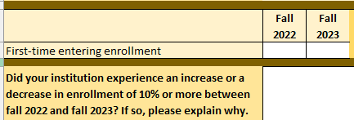
Wording Changes
Annual: First Time Entering -> First Time Ever in College
Fall: First Time Entering -> New to Institution
Recap
Template Changes
Additional Metrics
Wording Changes

Slide 14
Wording Changes
Annual: # of Courses in which students enrolled/completed -> Total Course Enrollment/Total Successful completers
Annual: Earned GED -> Earned High School Equivalency (e.g., GED, HiSET, etc.)
Recap
Template Changes
Additional Metrics
Wording Changes

Slide 15
Next Steps
Codebook and Qualtrics Translation Working Group Meetings
Next Month’s Focus:
JD Lopez
Left Overs
Freeze Date/Census Discussion
PDP Overlap

